Slide 1

Solving Non-linear equation
Fixed point iteration
不正经讲师：理科宅Hunt

Slide 2

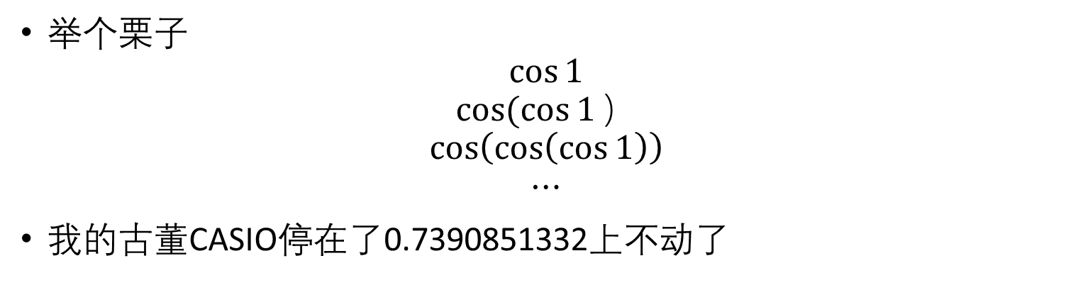
Fix-point iteration - 不动点迭代
举个栗子
$$\cos{1}$$
$$cos⁡(\cos{1}）$$
$$\cos\left(\cos\left(\cos{1}\right)\right)$$
$$⋯$$
我的古董CASIO停在了0.7390851332上不动了

Slide 3

Fixed point – 不动点
Def: A fixed point of a function $f(x)$ is a point $p$ such that $f\left(p\right)=p$.
举个例子，对于函数 $f\left(x\right)=x(x−2)来说$，$x=0, x=3$都是不动点

Slide 4




Contraction mapping – 收缩映射
Def: Let $(X, d)$be a complete metric space. Then a map $T : X → X$is called a contraction mapping on $X$ if there exists $q ∈ [0, 1)$such that
$$d\left(T\left(x\right),T\left(y\right)\right)≤q⋅d\left(x,y\right), ∀x,y∈X$$
$$x$$
$$y$$
$$T(x)$$
$$T(y)$$

Slide 5

Banach fixed point theorem - 不动点定理
Let $(X,d)$ be a non-empty complete metric space with a contraction mapping $T:X→X$. Then $T$ admits a unique fixed-point $p$ in $X$ (i.e. $T(p) =p$).
Furthermore, $p$ can be found as follows: start with an arbitrary element $x_{0}$ in $X$ and define a sequence $\{x_{n}\}$ by $x_{n} = T(x_{n}−1)$ for $n ≥ 1$. Then $x_{n} →p$.

Slide 6

Simplified condition
我都没学过度量空间，能说人话吗？
Proposition: If $f(x)$ is differentiable and $\left|f^{′}\left(x\right)\right|<1$ for $x$ in some closed interval $I$, then $f$ has a unique fixed point in $I$.
$\left|f^{′}\right|<1$只是个sufficient condition, 并不是necessary condition哦！

Slide 7

Example - 举个栗子
Find the fixed points of $f\left(x\right)=x(x−2)$. And explain what will happen to the sequence $\{x_{n}\}$ if $x_{0}<0$, $x_{0}∈[0, 4]$, $x_{0}>4$.

Slide 8
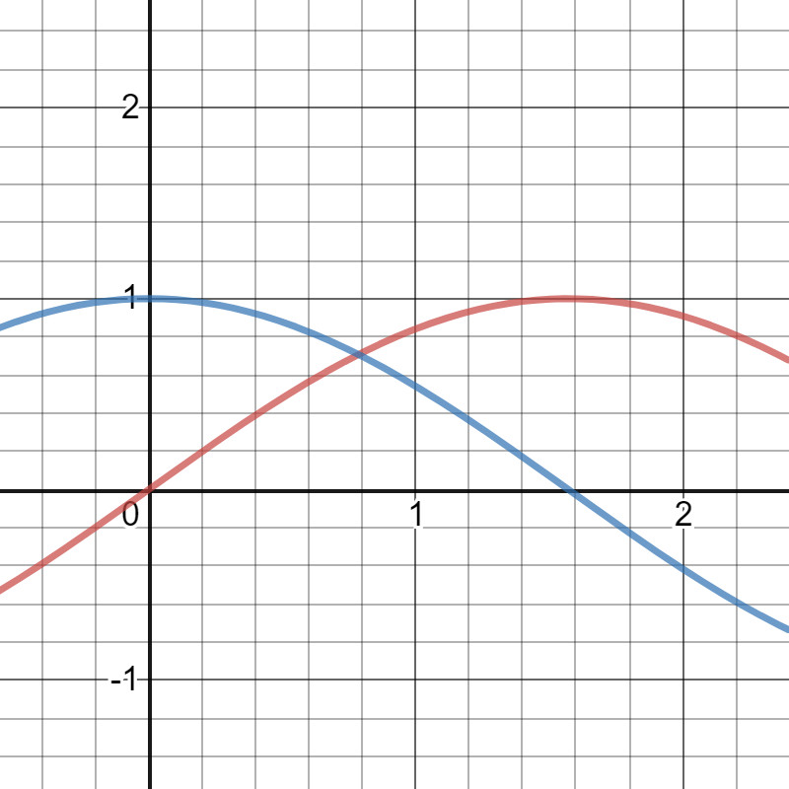

Connection to solving equation
说了这么多，跟解方程有啥关系？
Find the solution to $\cos{x}=\sin{x}$ on interval $[0,1]$ using fixed point iteration.

Slide 9

Conclusion – 总结
$f(x)的$不动点就是在变换下不变的点 $f\left(p\right)=p$
在某段区间$I$上$\left|f^{′}\right|<1$ 可以推出$f在I$上是收缩映射，从而在$I上$必定有唯一的不动点
可以用不动点来解方程
值得一提，著名的牛顿迭代法（下节课讲）就是利用了不动点迭代

